Slide 1

“To predict the future attrition on the collected human resource data”
Project Presented by:
Trainer
Mrs. Amruta Chimote
(Edubridge learning pvt.ltd)
2021 - 2022
Ms. Arunmathi
Ms. Aishwariya
Mr. Darshan

Slide 2
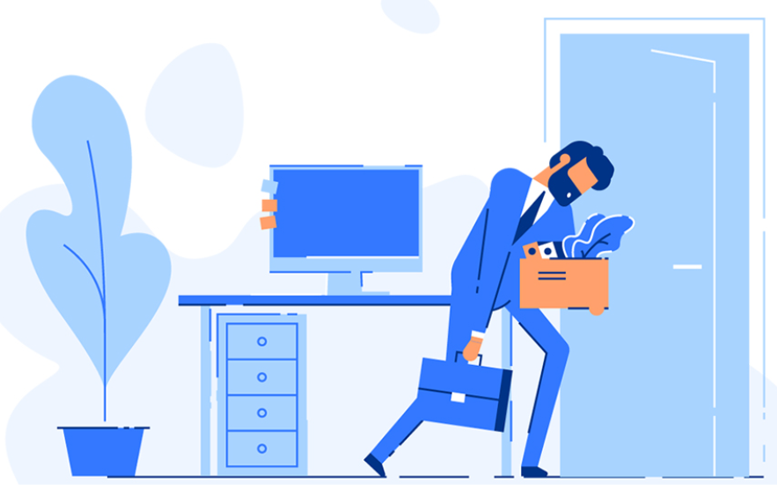

About project
Aim: To identify the features affecting employee’s attrition and predict the future attrition.
Objectives: Providing the solution to reduce the attrition rate for future.
Data Source - Kaggle

Slide 3
Content
TOPICS | PAGE NO
Data collection & Preprocessing | 4
Exploratory data Analysis | 5
Machine Learning | 16
Prediction Model | 17
Predicting on random data | 18
Findings & Solution | 19

Slide 4



DATA COLLECTION AND PREPROCESSING:
Importing libraries
Numpy & Pandas ->used for EDA
Seaborn & Matplotlib -> used for visualization
Sklearn ->used for creating prediction model
Importing dataset-> “Human Resource.csv” using “pd.read_csv” and saving it to variable “data”
Shape of the data-> 14999 rows & 10 columns using using ‘data.shape’

Slide 5
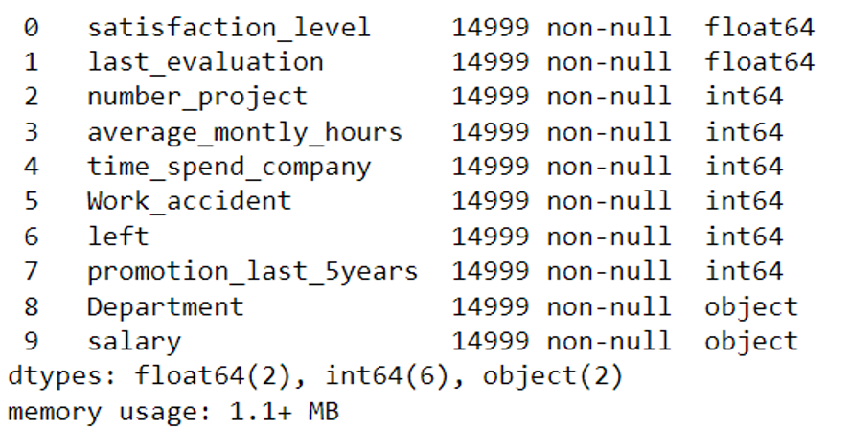
Column names & datatypes ->
using ‘data.info()’
2 Floats
2 objects
6 integers
Null values -> using ‘data.isnull().sum()’ we identified there are no null values in a data set.

Slide 6
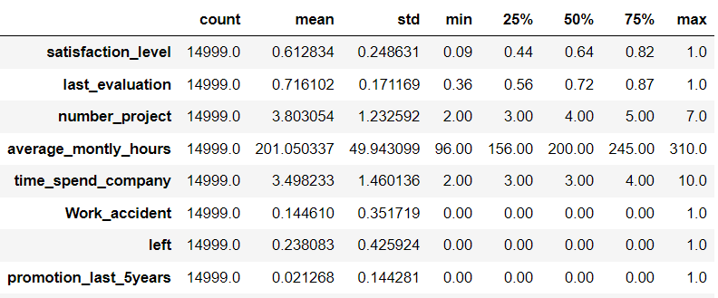
Description of a dataset ->
Considering “left” column as a targeted value ->
0 -> 11428(working in a company)
1 -> 3571 (who left the company)

Slide 7
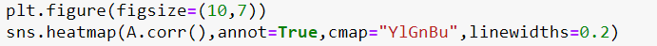
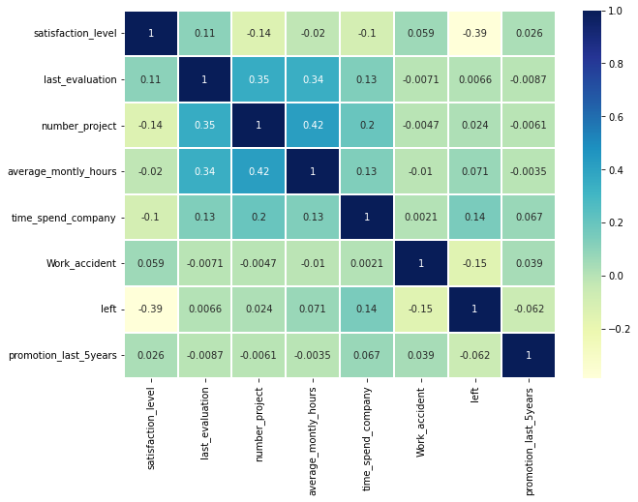
3 negative correlation – satisfaction level, work accident and promotion last 5 year(negligible)

Slide 8
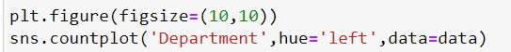
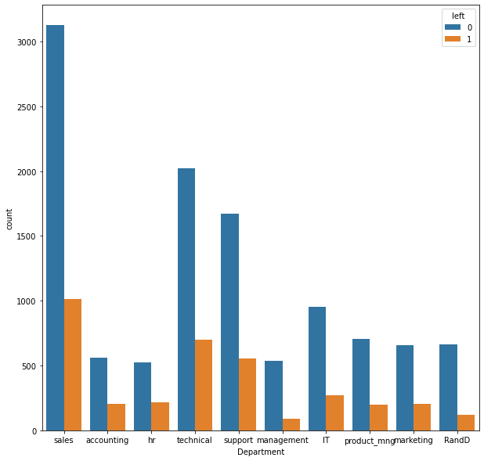
10 departments.
1000 employees left the company from sales department.
less than 150 employees left the company from management department.

Slide 9
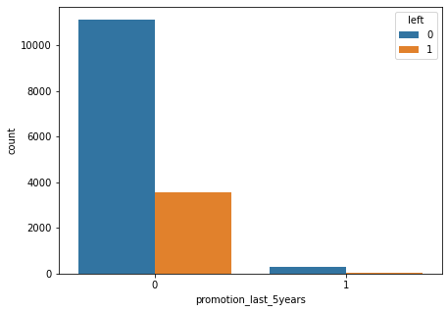
We can see that more than 3500 employees left job who did not got promotion in last 5 years.
Employee achieving promotion are less likely to leave the company.

Slide 10
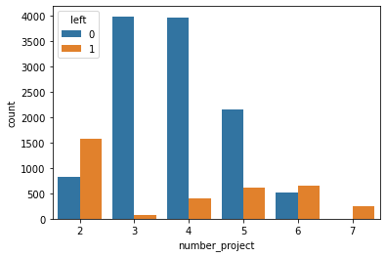
We can identify that most of the people who left the job have done 2 projects and employees who did 5 to 6 project also left the work.

Slide 11
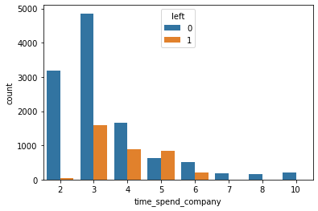
Employees who spent time in between 3 to 6 have left the work.

Slide 12
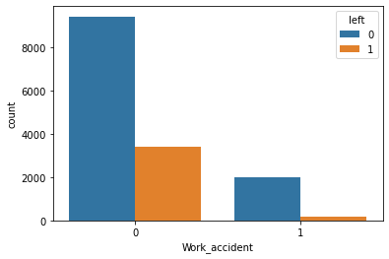
Employees who had history of zero work accident has more number of attrition.

Slide 13
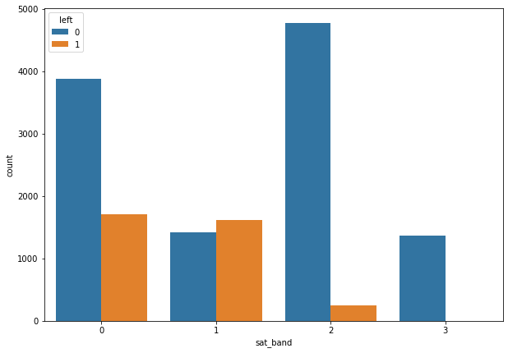
Employees who gave the satisfaction rating between 0.0 to 0.50 have more attrition.
0 = 0.0 to 0.25
1 = 0.25 to 0.50
2 = 0.50 to 0.75
3 = 0.75 to 0.95

Slide 14
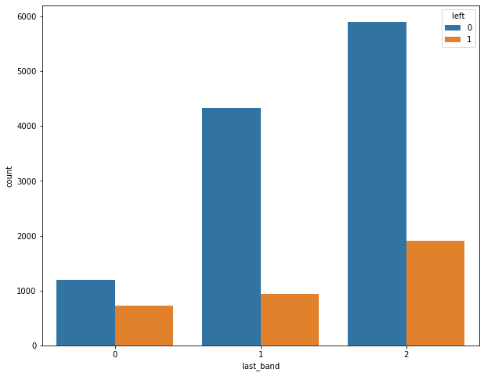
Employees who got rating more than 0.7 have more attrition.
0 = 0.0 to 0.5
1 = 0.5 to 0.7
2 = greater than 0.7

Slide 15
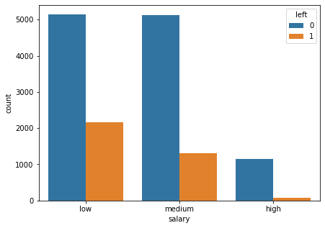
It can be clearly seen that most of the employees who left the job were earning low income or medium income
and very less proportion of employees are there who left their job and were earning high income.
This implies that Salary is a major factor in determining the Employee Retention

Slide 16
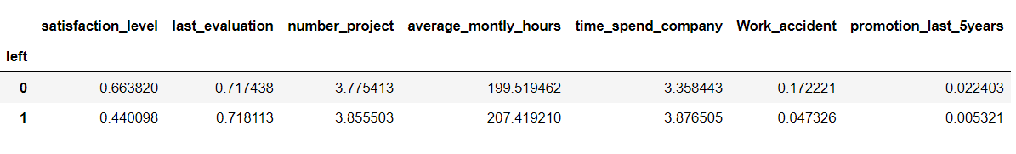
MACHINE LEARNING ->
It is a type of AI that allows software application to become more accurate at predicting outcomes.
ML uses historical data as input to predict new output values.
PREPROCESSING OF PREDICTION MODEL ->
Using concate function to balancing the targeted value(Left) 0->3571 & 1->3571
Using LabelEncoder to convert string values (Department & Salary) into numerical values.

Slide 17
SPLITTING DATA INTO TRAINING DATA AND TESTING DATA –>
Importing train_test_split from sklearn.model_selection
Data splitted into X_train,X_test,Y_train,Y_test
Training data consists 80% & testing data consists 20% from original dataset
PREDICTION MODELS ->
Importing ‘DecisionTreeClassifier’ from sklearn.tree
Importing ‘SVM’ from sklearn
Importing ‘LogesticRegression’ from sklearn.linear_model
 | Decision tree classifier | SVM | Logistic Regression
X_Train | 100.0 | 65.74 | 75.54
X_Test | 95.38 | 66.41 | 75.57
Fit | Over-fit | Under-fit | Good-fit

Slide 18
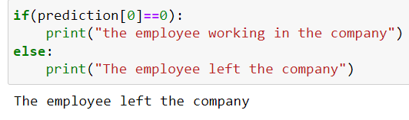
Reason for importing DecisionTreeClassifier, SVM & Logistic regression models ->
Simple to understand, to interpret and very efficient to train.
Requires little data preparation
Used to predict a discrete output, for example (0 & 1), (Yes or NO)
PREDICTING USING RANDOM DATA ->
Changing input data to a numpy array
Reshape the numpy array as we are predicting for only an instance

Slide 19
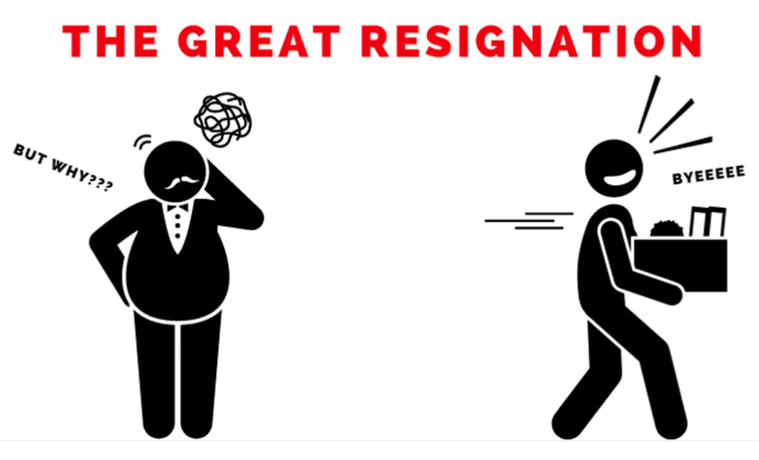
Major findings and Solution:
Sales department has more attrition rate.
Salary, promotion and time spent in the company criteria affected directlty on attrition rate.
Surprisingly Work accident has inversely affected attrition rate.
Employees who done 2 or less project has more attrition rate.

Slide 20

Thank you
Mentor
Mrs. Amrutha Chimote

